Slide 1

Python Function
Introduction to Programming
Comp07027
Lecture 7: Python Functions (1)
Dr Muhammad Aslam
Lecturer UWS Wuxi
Muhammad.Aslam@uws.ac.uk

Slide 2
Python Functions
In Python, the function is a block of code defined with a name.
We use functions whenever we need to perform the same task multiple times without writing the same code again.
It can take arguments and returns the value.
Python has a DRY principle like other programming languages. DRY stands for Don’t Repeat Yourself.
Consider a scenario where we need to do some action/task many times.
We can define that action only once using a function and call that function whenever required to do the same activity.
Function improves efficiency and reduces errors because of the reusability of a code. Once we create a function, we can call it anywhere and anytime. The benefit of using a function is reusability and modularity.

Slide 3
Types of Functions
Python support two types of functions
Built-in function
User-defined function
Built-in function: The functions which are come along with Python itself are called a built-in function or predefined function. Some of them are listed below.
range(), type(), input() print (), len() etc.
Python range() function generates the immutable sequence of numbers starting from the given start integer to the stop integer.
for i in range(1, 10): print(i, end=' ') # Output 1 2 3 4 5 6 7 8 9

Slide 4
User-defined function
Functions which are created by programmer explicitly according to the requirement are called a user-defined function.
Creating a Function
Use the following steps to define a function in Python.
Use the def keyword with the function name to define a function.
Next, pass the number of parameters as per your requirement. (Optional).
Next, define the function body with a block of code. This block of code is nothing but the action you wanted to perform.
In Python, no need to specify curly braces for the function body. The only indentation is essential to separate code blocks. Otherwise, you will get an error.

Slide 5
Syntax of creating a function
Syntax of creating a function
def function_name(parameter1, parameter2): # function body # write some action return value
function_name: Function name is the name of the function. We can give any name to function.
parameter: Parameter is the value passed to the function. We can pass any number of parameters. Function body uses the parameter’s value to perform an action
function_body: The function body is a block of code that performs some task. This block of code is nothing but the action you wanted to accomplish.
return value: Return value is the output of the function.
Note: While defining a function, we use two keywords, def (mandatory) and return (optional).

Slide 6
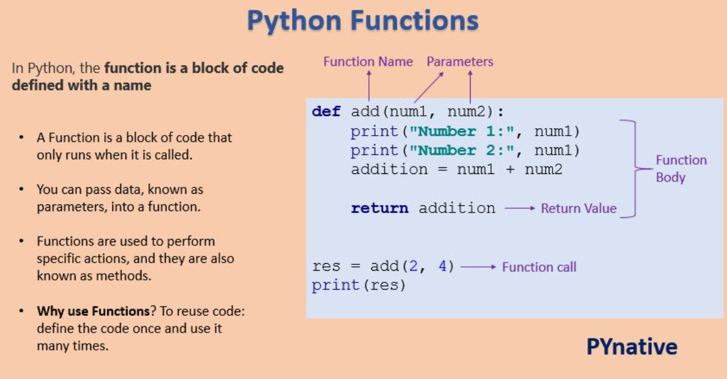
Function Basic Flowchart

Slide 7
Creating a function without any parameters
Now, Let’s the example of creating a simple function that prints a welcome message.
def message(): print("Welcome to PYnative") # call function using its name message()

Slide 8
Creating a function with parameters
Let’s create a function that takes two parameters and displays their values.
In this example, we are creating function with two parameters ‘ name’ and ‘age’.
# function
# function def course_func(name, course_name): print("Hello", name, "Welcome to PYnative") print("Your course name is", course_name) # call function course_func('John', 'Python')

Slide 9
Creating a function with parameters and return value
Functions can return a value. The return value is the output of the function. Use the return keyword to return value from a function.
def calculator(a, b): add = a + b # return the addition return add # call function # take return value in variable res = calculator(20, 5) print("Addition :", res)

Slide 10
Calling a function
Once we defined a function or finalized structure, we can call that function by using its name. We can also call that function from another function or program by importing it.
To call a function, use the name of the function with the parenthesis, and if the function accepts parameters, then pass those parameters in the parenthesis.
def even_odd(n): # check numne ris even or odd if n % 2 == 0: print('Even number') else: print('Odd Number') # calling function by its name even_odd(30)

Slide 11
Calling a function of a module
You can take advantage of the built-in module and use the functions defined in it.
For example, Python has a random module that is used for generating random numbers and data.
It has various functions to create different types of random data.
Let’s see how to use functions defined in any module.
First, we need to use the import statement to import a specific function from a module.
Next, we can call that function by its name.
# import randint function from random import randint # call randint function to get random number print(randint(10, 20))

Slide 12
Docstrings
In Python, the documentation string is also called a docstring. It is a descriptive text (like a comment) written by a programmer to let others know what block of code does.
We write docstring in source code and define it immediately after module, class, function, or method definition.
It is being declared using triple single quotes (''' ''') or triple-double quote(""" """).
We can access docstring using doc attribute (__doc__) for any object like list, tuple, dict, and user-defined function, etc.

Slide 13
Multi-Line Docstring
A multi-line Docstrings is the same single-line Docstrings, but it is followed by a single blank line with the descriptive text.
The general format of writing a multi-line Docstring is as follows:
# Multi-line Docstring def any_fun(parameter1): """ Description of function Arguments: parameter1(int):Description of parameter1 Returns: int value """ print(any_fun.__doc__)

Slide 14
Return Value From a Function
In Python, to return value from the function, a return statement is used. It returns the value of the expression following the returns keyword.
Syntax of return statement
def fun(): statement-1 statement-2 statement-3 . return [expression]

Slide 15
Example: Return Value From a Function
The return value is nothing but a outcome of function.
The return statement ends the function execution.
For a function, it is not mandatory to return a value.
If a return statement is used without any expression, then the None is returned.
The return statement should be inside of the function block.
def is_even(list1): even_num = [] for n in list1: if n % 2 == 0: even_num.append(n) # return a list return even_num # Pass list to the function even_num = is_even([2, 3, 42, 51, 62, 70, 5, 9]) print("Even numbers are:", even_num)

Slide 16
Return Multiple Values
You can also return multiple values from a function.
Use the return statement by separating each expression by a comma.
Example: –
In this example, we are returning three values from a function. We will also see how to process or read multiple return values in our code.
def arithmetic(num1, num2): add = num1 + num2 sub = num1 - num2 multiply = num1 * num2 division = num1 / num2 # return four values return add, sub, multiply, division print(arithmetic(10, 2)) # read four return values in four variables a, b, c, d = arithmetic(10, 2) print("Addition: ", a) print("Subtraction: ", b) print("Multiplication: ", c) print("Division: ", d)

Slide 17
The pass Statement
In Python, the pass is the keyword, which won’t do anything. Sometimes there is a situation where we need to define a syntactically empty block. We can define that block using the pass keyword.
When the interpreter finds a pass statement in the program, it returns no operation.
# The pass statement for function def addition(num1, num2): # Implementation of addition function in coming release # Pass statement pass addition(10, 2)

Slide 18
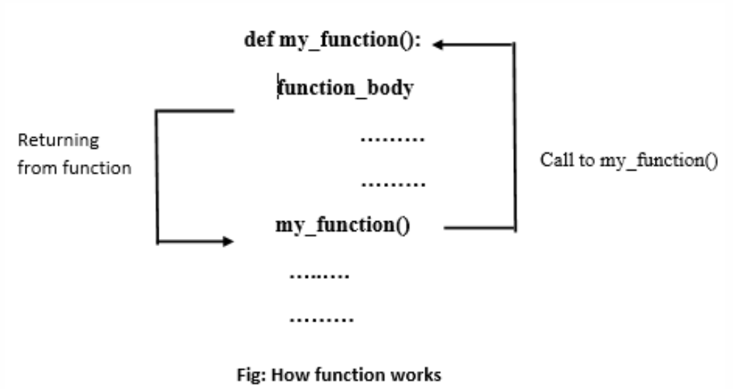
How does Function work in Python?
In Python, functions allow the programmer to create short and clean code to be reused in an entire program.
The function helps us to organize code. The function accepts parameters as input, processes them, and in the end, returns values as output.
Let’s assume we defined a function that computes some task. When we call that function from another function, the program controller goes to that function, does some computation, and returns some value as output to the caller function.

Slide 19
Scope and Lifetime of Variables
When we define a function with variables, then those variables’ scope is limited to that function. In Python, the scope of a variable is an area where a variable is declared. It is called the variable’s local scope.
We cannot access the local variables from outside of the function. Because the scope is local, those variables are not visible from the outside of the function.
Note: The inner function does have access to the outer function’s local scope.
When we are executing a function, the life of the variables is up to running time. Once we return from the function, those variables get destroyed. So function does no need to remember the value of a variable from its previous call.

Slide 20
Example: Scope and Lifetime of Variables
# Varibale scope and areas global_lang = 'DataScience' def var_scope_test(): local_lang = 'Python' print(local_lang) var_scope_test() # Output 'Python' # outside of function print(global_lang) # Output 'DataScience' # NameError: name 'local_lang' is not defined print(local_lang)

Slide 21
Local Variable in function
A local variable is a variable declared inside the function that is not accessible from outside of the function. The scope of the local variable is limited to that function only where it is declared.
If we try to access the local variable from the outside of the function, we will get the error as NameError.
def function1(): # local variable loc_var = 888 print("Value is :", loc_var) def function2(): print("Value is :", loc_var) function1() function2()

Slide 22
Global Variable in function
A Global variable is a variable that declares outside of the function. The scope of a global variable is broad. It is accessible in all functions of the same module.
# Global Variable use global_var = 999 def function1(): print("Value in 1nd function :", global_var) def function2(): print("Value in 2nd function :", global_var) function1() function2()

Slide 23
Global Keyword in Function
In Python, global is the keyword used to access the actual global variable from outside the function. we use the global keyword for two purposes:
To declare a global variable inside the function.
Declaring a variable as global, which makes it available to function to perform the modification.
Let’s see what happens when we don’t use global keyword to access the global variable in the function

Slide 24
Example: Global Keyword in Function
# Global variable global_var = 5 def function1(): print("Value in 1st function :", global_var) def function2(): # Modify global variable # function will treat it as a local variable global_var = 555 print("Value in 2nd function :", global_var) def function3(): print("Value in 3rd function :", global_var) function1() function2() function3()
As you can see, function2() treated global_var as a new variable (local variable). To solve such issues or access/modify global variables inside a function, we use the global keyword.

Slide 25
Example: Global Keyword in Function
global keyword.
# Global variable x = 5 # defining 1st function def function1(): print("Value in 1st function :", x) # defining 2nd function def function2(): # Modify global variable using global keyword global x x = 555 print("Value in 2nd function :", x) # defining 3rd function def function3(): print("Value in 3rd function :", x) function1() function2() function3()

Slide 26
Questions??

